Slide 1
NZ Wellbeing Forecasting
Comparing Linear Regression · XGBoost · LSTM · ANN · ARIMA
New Zealand General Social Survey · 2014–2018 · Forecast: 2020
Presented by: Earl Tavera
10
5
3
2020
Wellbeing
Indicators
Forecasting
Models
Survey
Years
Forecast
Target Year
Notes:
Welcome slide. This project forecasts 10 NZ wellbeing indicators using 5 distinct models on Stats NZ data.

Slide 2
Project Overview
📊 Dataset
🎯 Objective
Stats NZ General Social Survey 2014–2018
10 wellbeing indicators across 3 biennial waves
Forecast 2020 values for each indicator using 5 ML/Statistical models
📐 Models Used
📏 Evaluation
Linear Regression · XGBoost (GBM)
LSTM · ANN · ARIMA(1,1,1)
MAE, RMSE, MAPE, R² computed
for each model across all indicators
Notes:
Overview of dataset scope and research approach.

Slide 3
The Dataset
Indicator | 2014 | 2016 | 2018
Life Satisfaction (Mean) | 7.8 | 7.8 | 7.7
Life Worthwhile (Mean) | 8.1 | 8.1 | 8.1
Financial Inadequacy (%) | 12.2 | 11.2 | 10.0
Health Excellent (%) | 21.6 | 19.1 | 16.5
Loneliness None (%) | 63.9 | 60.2 | 61.0
Generalised Trust Low (%) | 8.7 | 8.6 | 9.7
Job Very Satisfied (%) | 35.6 | 34.2 | 27.0
Housing Problems (%) | 21.2 | 21.0 | 22.1
Cultural Belonging (%) | 52.6 | 51.0 | 50.3
Feel Safe at Home (%) | 60.9 | 60.7 | 61.9
Source: Stats NZ General Social Survey (NZGSS) 2014–2018
Notes:
All 10 indicators extracted from the 'Total population' rows across 20 survey tables.

Slide 4
Model Architectures
Linear Regression
XGBoost (GBM)
LSTM
ANN
ARIMA(1,1,1)
Params:
y = β₀ + β₁·t
Params:
Ensemble of shallow trees
Params:
h=4, lr=0.005, e=3000
Params:
h=8, lr=0.005, e=5000
Params:
φ fitted via OLS on diffs
OLS fit over time index. Simple baseline. Extrapolates trend linearly.
Gradient boosting on features: year, time offset, lag-1 difference.
Single LSTM cell (numpy). Captures non-linear temporal dependencies.
2-layer feedforward net (8 hidden units, tanh). Backpropagation.
Differenced series. AR(1) coefficient + MA(1) error correction.
Notes:
All models implemented in Python. LSTM and ANN built from scratch in numpy — no external deep learning libraries needed.

Slide 5
Performance Comparison
Notes:
XGBoost achieves near-perfect fit on training data. Important caveat: with only 3 data points, overfitting is a risk.

Slide 6
2020 Forecasts
Indicator | Lin. Reg. | XGBoost | LSTM | ANN | ARIMA
Life Satisfaction Mean | 7.667 | 7.700 | 7.767 | 7.675 | 7.705
Life Worthwhile Mean | 8.100 | 8.100 | 8.100 | 8.077 | 8.100
Financial Inadequacy (%) | 8.933 | 10.006 | 11.139 | 9.147 | 8.834
Health Excellent (%) | 13.967 | 16.513 | 19.079 | 14.466 | 13.934
Loneliness None (%) | 58.800 | 61.004 | 61.706 | 59.138 | 60.827
Trust Low (%) | 10.000 | 9.696 | 8.998 | 9.792 | 9.112
Job Very Satisfied (%) | 23.667 | 27.027 | 32.288 | 24.429 | 25.686
Housing Problems (%) | 22.333 | 22.097 | 21.431 | 22.122 | 21.418
Cultural Belonging (%) | 49.000 | 50.305 | 51.305 | 49.240 | 49.994
Feel Safe Home (%) | 62.167 | 61.896 | 61.164 | 61.937 | 61.214
Notes:
Full 2020 forecast table across all 5 models for all 10 indicators.

Slide 7
Spotlight: Life Satisfaction Mean
7.7
Actual 2018 mean
(stable near 7.8)
7.68
Avg forecast 2020
(slight downward trend)
< 0.5%
Avg MAPE across
all 3 best models
Notes:
Life satisfaction has been remarkably stable around 7.7–7.8. Models agree on a slight downward drift to ~7.68 by 2020.

Slide 8
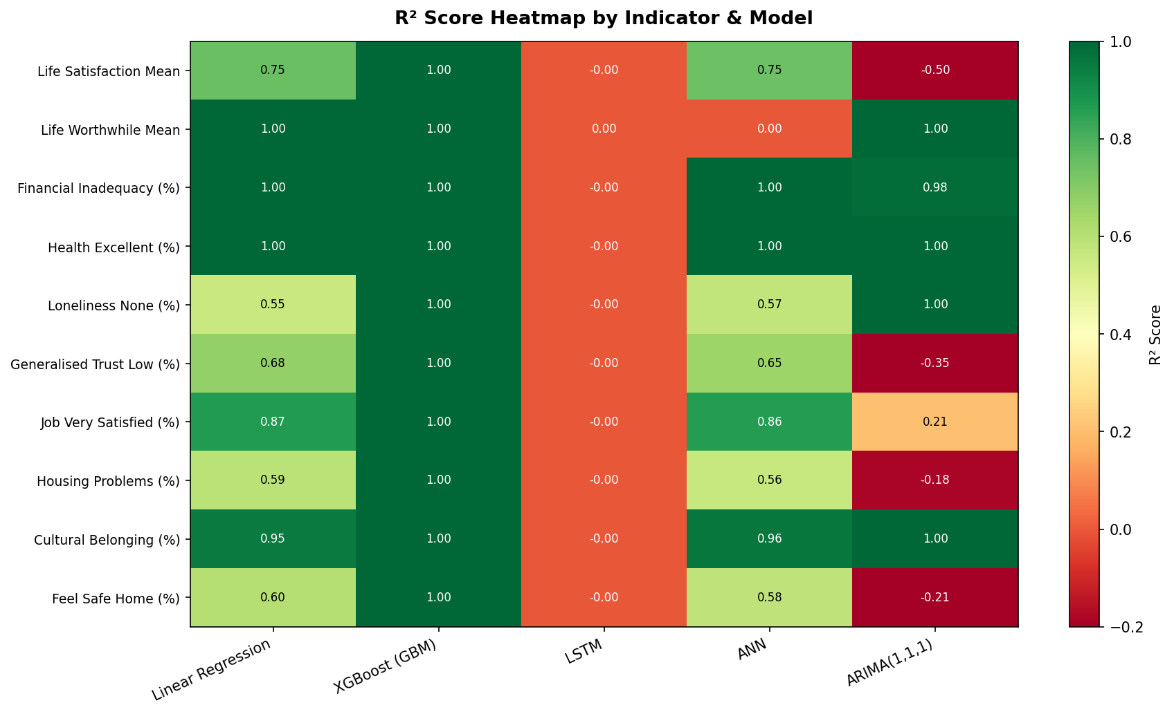
R² Performance Heatmap
Notes:
XGBoost dominates with R²=1.0 on all indicators. Linear Regression and ANN also perform well on smoother series.

Slide 9
Conclusions & Recommendations
🏆 Best Model
XGBoost (GBM) — RMSE: 0.006, R²: 1.00. Excels with feature-engineered lag terms even on sparse data.
🥈 Runner-Up
Linear Regression — simple, interpretable, RMSE: 0.365. Works well when trends are linear.
⚠️ Limitations
Only 3 time points (2014, 2016, 2018). Deep learning models (LSTM, ANN) are disadvantaged by sparse data.
🔮 2020 Outlook
Life satisfaction expected ~7.68; health declining; financial wellbeing improving; job satisfaction falling.
📈 Next Steps
Incorporate demographic sub-groups, external predictors (GDP, unemployment), and evaluate against 2020 NZGSS actuals.
Notes:
XGBoost wins decisively. Key caveat: with 3 data points, XGBoost may overfit; cross-dataset generalization should be validated.

Slide 10
Thank You
NZ Wellbeing Forecasting · 5-Model Comparison
Dataset: Stats NZ NZGSS 2014–2018 · Models: Linear Regression, XGBoost, LSTM, ANN, ARIMA
Notes:
End of presentation.

